Slide 1


Ahsanullah University of Science and Technology
Computer Science and Engineering Department
Emotion Detection from Text
Presented By-
Nowshin Rumali 160204107
Rejone-E-Rasul Redoy 170104116
Mehedi Hasan Sami 170104118
Presented To-
Faisal Muhammad Shah, Associate Professor
Farzad Ahmed, Lecturer
Md. Tanvir Rouf Shawon, Lecturer

Slide 2


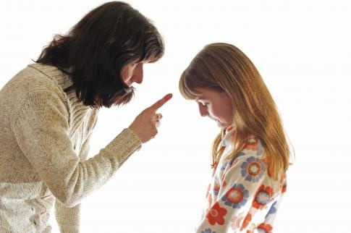
Motivation
“Our feelings are our most genuine paths to knowledge.” – Audre Lorde

Slide 3
Objectives
1
Joy
2
Surprised
3
Sadness
4
5
6
Anger
Love
Fear
Text Analysis Emotion Detection
Machine Learning Techniques and Algorithms
6 basic emotions
Accuracy of Detected Emotions
Six Emotions Predict

Slide 4
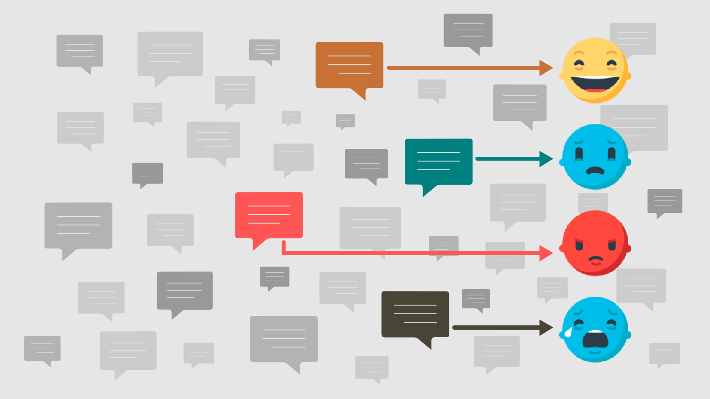
Introduction
Text
Analysis
Model
Accuracy
Emotion
Predict
Detecting and recognizing emotions through the expressions from sentences
Machine Learning algorithms used
Fig: Emotion Detection from Textual analysis

Slide 5
Background Study
Text Preprocessing
Feature Extraction
Machine Learning Algorithms
Performance Metrics
Paper:
Emotion Detection from Tweets using AIT-2018 Dataset
Dataset:
Tweet Emotion

Slide 6
Methodologies
Text
Preprocessing
Feature
Extraction
Testing
Dataset
6 Models
Evaluation
Punctuation Remove
Tokenization
Stopwords Remove
Lemmatization
Count Occurrence
TF-IDF
Support Vector Machine (SVM)
Logistic Regression
Random Forest Classifier
XGBoost Classifier
Multinomial Naive Bayes
Decision Tree Classifier
Accuracy Measure
Emotion Detect
Real Life Text Input
Accuracy Predict
Emotion Detect

Slide 7

Text Preprocessing
Raw Text
Text: | ‘Reading books make me happy…’
Punctuation Remove: | Reading books make me happy
Tokenization: | [‘reading’, ‘books’, ‘make’, ‘me’, ‘happy’]
Stopwords Remove: | [‘reading’, ‘books’, ‘make’, ‘happy’]
Lemmatization: | [‘reading’, ‘book’, ‘make’, ‘happy’]
Preprocessed Text
Table: Text Preprocessing Example

Slide 8

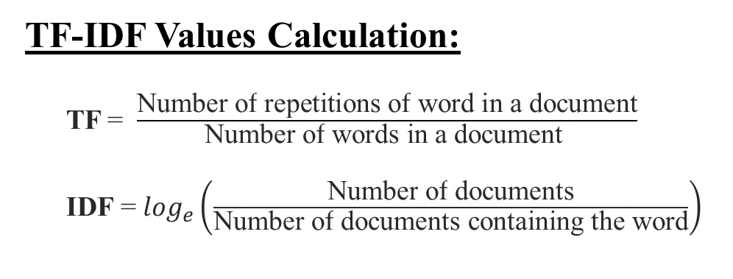
Feature Extraction
TF-IDF Values Calculation:
TF = $\frac{\text{Number} \text{of} \text{repetitions} \text{of} \text{word} \text{in} \text{a} \text{document}}{\text{Number} \text{of} \text{words} \text{in} \text{a} \text{document} }$
IDF = $\log_{e}\left(\frac{\text{Number} \text{of} \text{documents}}{\text{Number} \text{of} \text{documents} \text{containing} \text{the} \text{word}}\right)$
Words from Documents | TF values |  |  | IDF values
 | Doc 1 | Doc 2 | Doc 3
Creative | 0 | 0 | 0.33 | log_{e}(3/1)
Feel | 0.5 | 0.16 | 0.33 | log_{e}(3/3)
Grab | 0 | 0.16 | 0 | log_{e}(3/1)
Greedy | 0 | 0.16 | 0 | log_{e}(3/1)
Humiliate | 0.5 | 0 | 0 | log_{e}(3/1)
Minute | 0 | 0.16 | 0 | log_{e}(3/1)
Need | 0 | 0 | 0.33 | log_{e}(3/1)
Post | 0 | 0.16 | 0 | log_{e}(3/1)
Wrong | 0 | 0.16 | 0 | log_{e}(3/1)
TF-IDF Example:
Document 1: I didn’t feel humiliated.
Document 2: I’m grabbing a minute to post I feel greedy wrong.
Document 3: I have been feeling the need to be creative.

Slide 9
Models
Support Vector Machine
Decision
Tree Classifier
Logistic Regression
Six Models
Models
Multinomial Naïve Bayes
Random Forest Classifier
XGBoost Classifier

Slide 10

Performance Metrics

Slide 11
Conclusion
1. Textual Analysis and Emotions Detection
2. Six Models - Implemented and Compared
3. Highest Accuracy from SVM Model – 89.52%

Slide 12
Future Works
Accuracy Improve
Balanced Dataset
Chatbot

Slide 13
Thank You

